Slide 1
Physical mathematics 1.1 Statements
Assumptions of Physics collaboration

Slide 2
Outline
Issue fundamental object (in math is a set)
Science is about describing the world, but not all descriptions of the world are science
Require -> Principle of scientific objectivity (examples of non-universal, contradictory, non-verifiable or semi-decidable)
Two parts: first solve non-contradiction, then solve evidence based
Statements
Problem of web of meaning, and idealization of statements (“conceptual cut”) -> statements being prime objects (i.e. unstructured)
Show the divide between formal and informal
Need justifications for axioms and definitions; axioms and definitions are chosen because they allow for simple justification (not because mathematicians like them)
Problems in capturing self-consistency (paradoxes, semantic and formal) -> Axiom of context
Truth is found experimentally, it has to be consistent with the meaning of the statements -> Axiom of possibility
Dependency between statements -> Axiom of closure
Logic operations, Equivalence (different equivalence), Boolean algebra, Narrowness and independence, minterms
Verifiable
Finite time verification (also idealization) – Not convenient to formalize the tests (knowing what is testable assumes knowing the laws of physics – circularity!)
Axiom of verifiability
Problem with NOT – falsifiable/decidable
Axioms of finite conjunction, countable disjunction
Summary of the logic

Slide 3

Formal system:
primitive notions
e.g. Euclidean geometry
Basic objects that are taken as-is, without definition in terms of other objects
E.g. Points and lines
formal language
Symbols and rules to write sentences in the formal system
E.g. $A,B,C$ for points $\overline{AB}$ for segment
axioms
Statements about primitive objects that are to be taken as true
E.g. Given two points, there is a line that joins them

Slide 4
Formal system for all of mathematics:
Sets + first-order logic + Zermelo–Fraenkel axioms (+ axiom of choice)
Formal system for all of physics:
???

Slide 5
formal language
Physics
Not an issue: we can simply use first-order logic
Physical requirements
Semantics
primitive notions
axioms
These should be justified by the physics
Formal system
Choose axioms/primitive notions so that the justification is straight forward
Physical objects live in the physical (informal) world
Informal
Formal
Mathematical objects are representations of physical objects
(e.g. connection to experiment is outside of the formal system)
physics
math
What can or cannot be captured by the formal system?

Slide 6
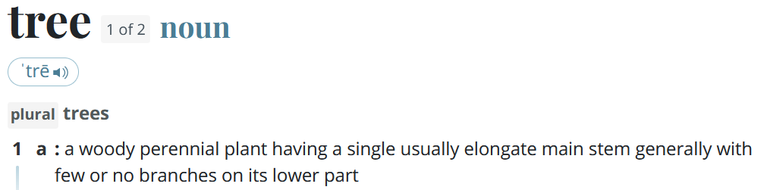
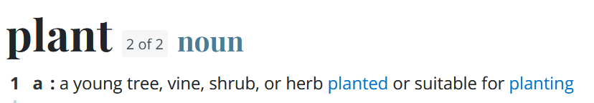
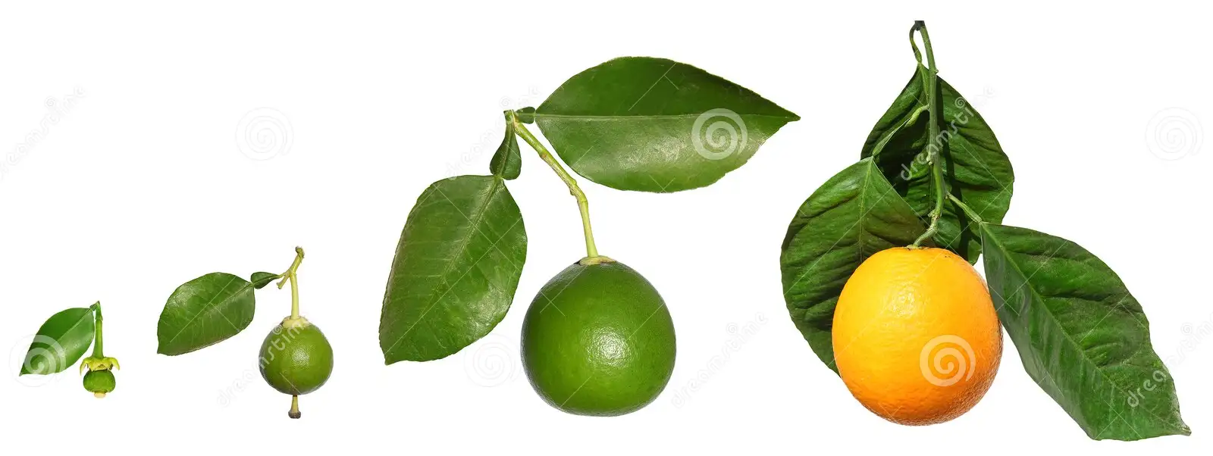
Problems in formalizing physical concepts
From merriam-webster.com:
Web of meaning
No primitive concepts: things are always defined in terms of other things
Conceptual cut
If one looks closely, all physical concepts are well-defined only within a restricted realm of applicability
dreamstime.com
When does an orange become an orange? Can we really define quantities (e.g. distance, time, temperature) with infinite precision?

Slide 7
Problems in formalizing physical concepts
Informal
Formal
Mathematical concepts are “crispier idealizations”
Physical concepts are “fuzzy”
physics
math
Mathematical concepts cannot have circular definitions
Physical concepts may have circular definitions
Not all physical concepts will carry into the formal system

Slide 8
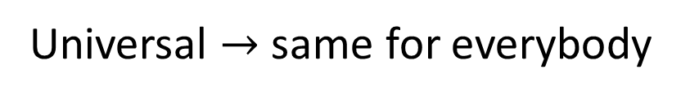
Universal $→$ same for everybody
First, let’s address these
Non-contradictory $→$ either something is true or false
Evidence based $→$ truth is determined experimentally
Statements: assertions that are universal and non-contradictory
Notes:
Examples -> Conclusion -> Some assertion are not universal
(Quine’s paradox – Yablo’s paradox) -> Logical consistency is not a property of individual statements -> Introduce the idea of logical contexts.

Slide 9
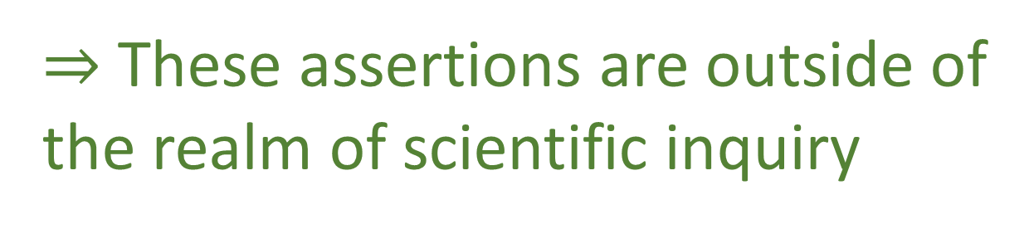
Not all assertions are universal
Jazz is marvelous
Different people may have different opinions
Green and red go well together
Is it morally justified to kill one person to save five
$⇒$ These assertions are outside of the realm of scientific inquiry

Slide 10
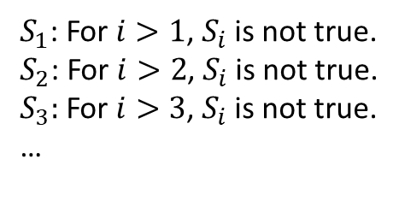
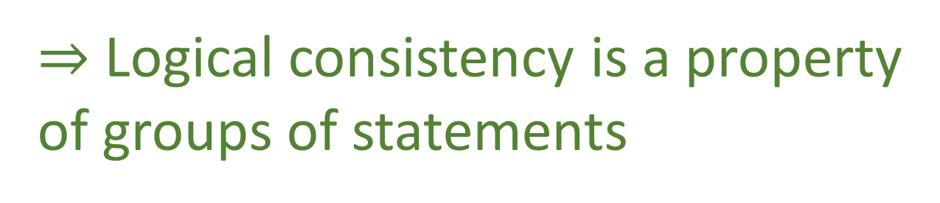
Not all assertions are non-contradictory
Liar paradox
“This sentence is false”
Quine’s paradox
“Yields falsehood when preceded by it’s quote” yields falsehood when preceded by its quote
Yablo’s paradox
$S_{1}$: For $i>1$, $S_{i}$ is not true.
$S_{2}$: For $i>2$, $S_{i}$ is not true.
$S_{3}:$ For $i>3$, $S_{i}$ is not true.
…
$⇒$ Logical consistency is a property
of groups of statements

Slide 11
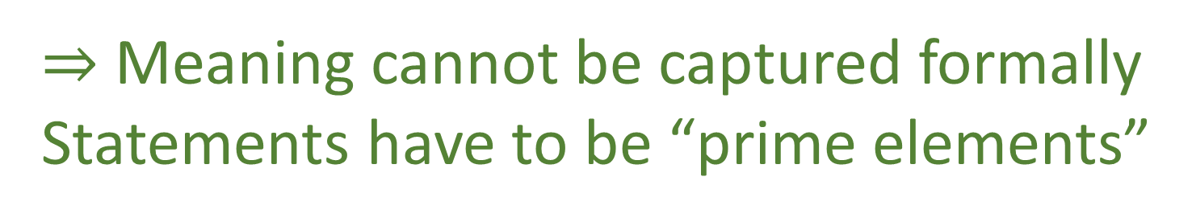
Not all assertions have clear meaning
Epistemic paradox
“I do not know that this statement is true”-> issue of semantics and grammar rules
Berry paradox
“The smallest positive integer that cannot be described in fewer than twenty-five words”-> issue of analytic, a priori objects
Sorites paradox
Imagine a heap of sand
Remove a grain of sand ; it remains a heap
Repeat until one remains
Is a single grain a heap? -> issue of unclear definition
$⇒$ Meaning cannot be captured formally
Statements have to be “prime elements”
Notes:
The statements are “prime elements”, no specified further (in terms of grammar, etc…), structure and meaning of the assertion is not part of the formal system (because it would be impossible… web of meaning)

Slide 12
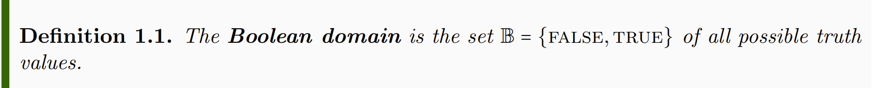
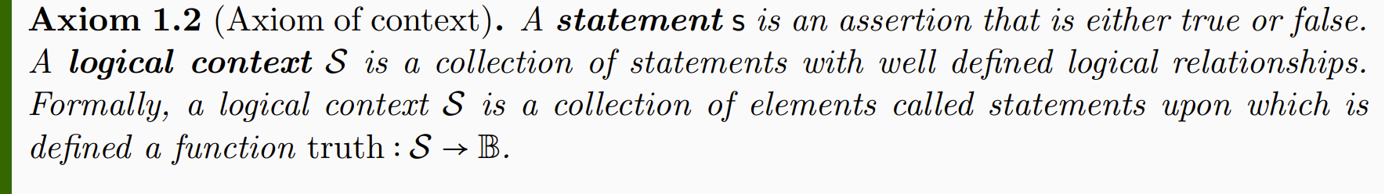
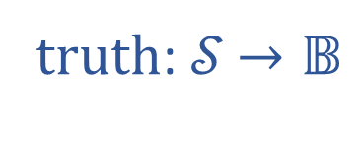

Informal part
Formal part
truth: 𝒮 $→𝔹$
𝒮
$$𝔹$$

Slide 13
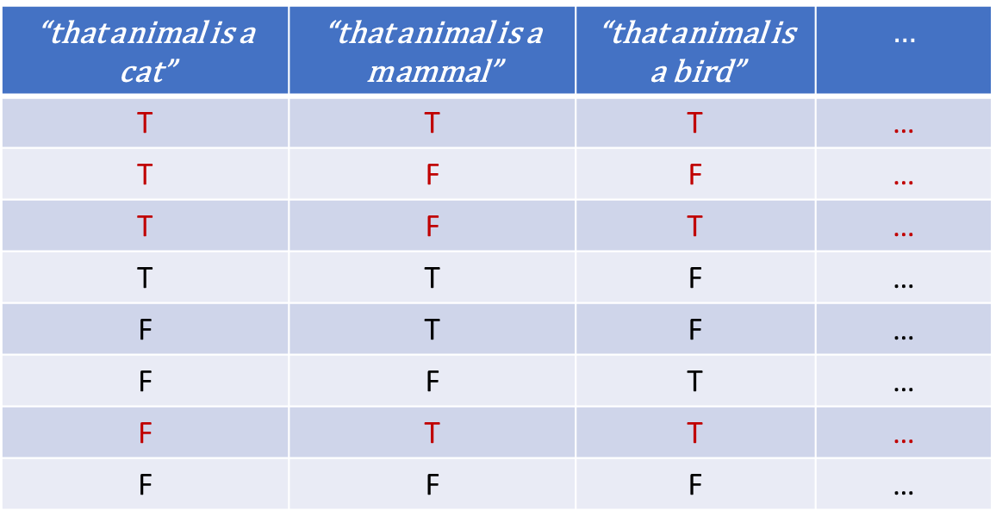
Not all combinations of truth values are logically possible
“that animal is a cat” | “that animal is a mammal” | “that animal is a bird” | $$…$$
T | T | T | …
T | F | F | …
T | F | T | …
T | T | F | …
F | T | F | …
F | F | T | …
F | T | T | …
F | F | F | …
The semantic content of the statement is captured by what combinations, or assignments, are possible
Notes:
Part of the semantic content of the statements is captured by what truth value can be assigned; Possible assignments are determined by the semantic content of the statements

Slide 14
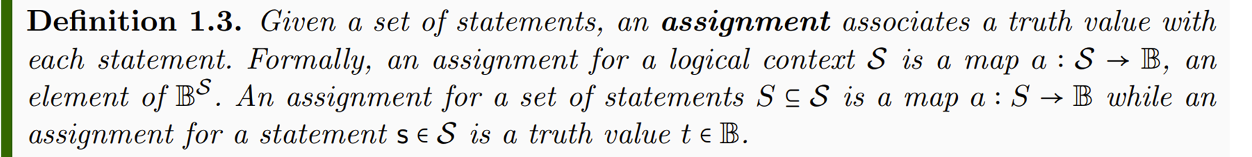
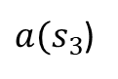
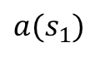
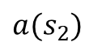
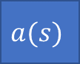

$$s_{1}$$ | $$s_{2}$$ | $$s_{3}$$ | …
$$a(s)$$
T | T | F | …
$$a(s_{1})$$
$$a(s_{2})$$
$a(s_{3}$)
Notes:
TODO: Add a … after the third statement

Slide 15
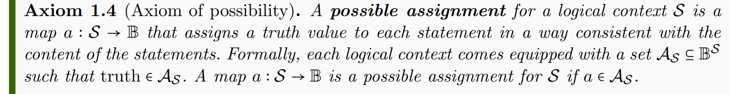


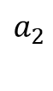
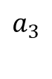
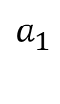
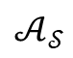
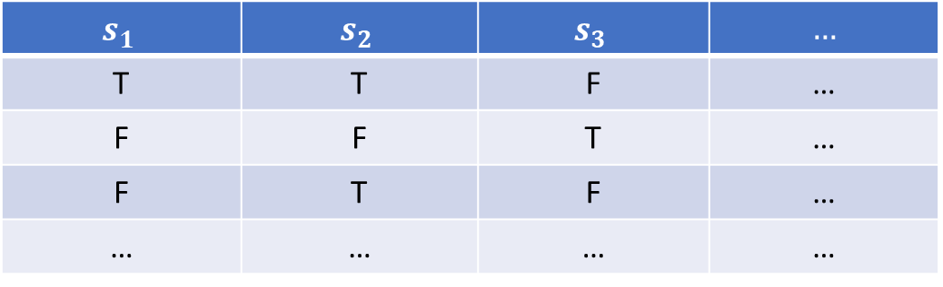
$$s_{1}$$ | $$s_{2}$$ | $$s_{3}$$ | $$…$$
T | T | F | …
F | F | T | …
F | T | F | …
… | … | … | …
$$a_{1}$$
$$a_{2}$$
$$𝒜_{𝒮}$$
$$a_{3}$$
$$…$$

Slide 16
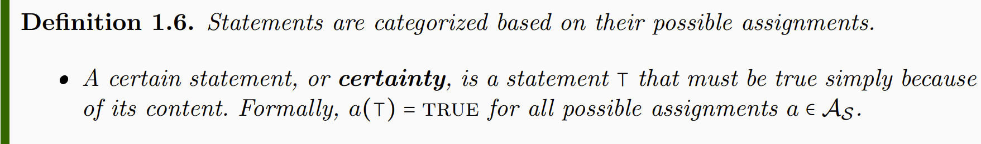
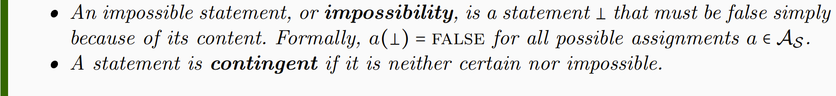
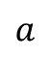
“that cat is a mammal” | “that mammal is a cat” | “that mammal is a bird”
T | T | F
T | F | F
T | F | F
T | T | F
… | … | …
$$a$$
Notes:
NOTE: whether a statement is a certainty or not depends on context. Mass of the electron: contingent if measuring the mass, certainty for particle identification

Slide 17
Notes:
Want to keep track whether the truth of one statement depends on the truth of others: function on truth values – introduce truth tables

Slide 18
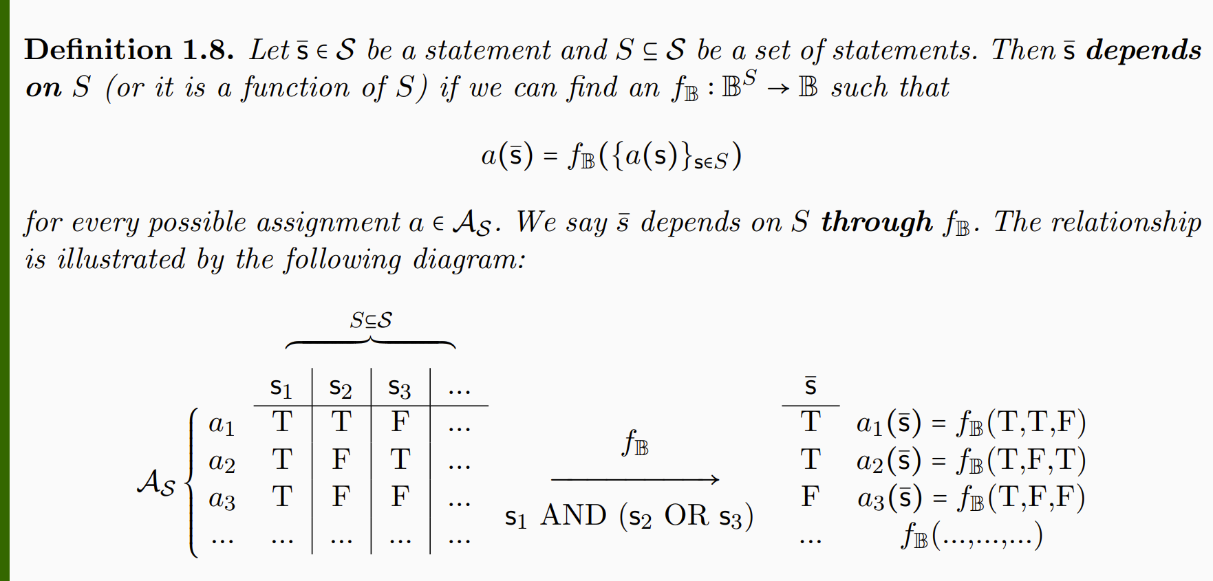
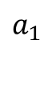
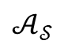
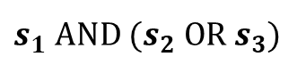
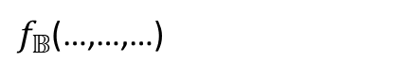
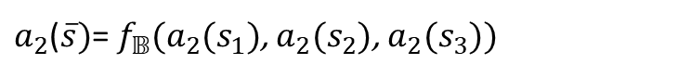
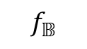
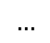
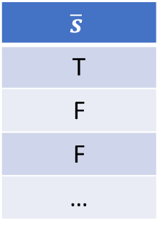
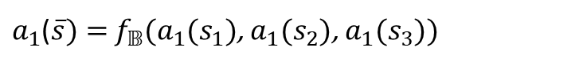
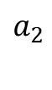
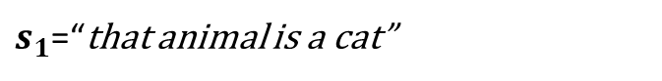
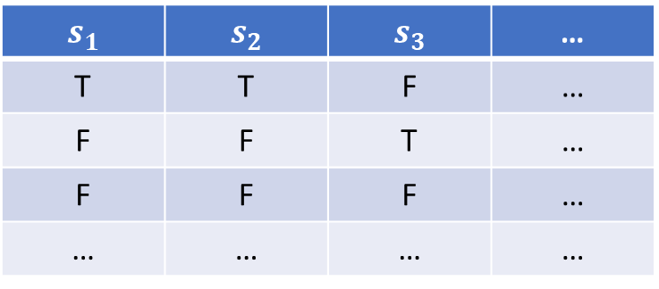
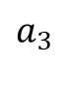
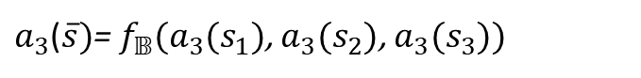
$$S$$
$$s_{1}$$ | $$s_{2}$$ | $$s_{3}$$ | …
T | T | F | …
F | F | T | …
F | F | F | …
… | … | … | …
$$\overline{s}$$
T
F
F
…
$$a_{1}$$
$a_{1}$($\overline{s})=$ $f_{𝔹}(a_{1}(s_{1})$, $a_{1}(s_{2}$), $a_{1}(s_{3}$))
$$a_{2}$$
$$f_{𝔹}$$
$a_{2}$($\overline{s})$= $f_{𝔹}(a_{2}(s_{1})$, $a_{2}(s_{2}$), $a_{2}(s_{3}$))
$$𝒜_{𝒮}$$
$$a_{3}$$
$s_{1}$ AND ${(s}_{2} OR{ s}_{3})$
$a_{3}$($\overline{s})$= $f_{𝔹}(a_{3}(s_{1})$, $a_{3}(s_{2}$), $a_{3}(s_{3}$))
$$…$$
$f_{𝔹}$(…,…,…)
$s_{1}$=“that animal is a cat”
$s_{2}$=“that animal is a mammal”
$s_{3}$=“that animal is a bird”
Notes:
Applying truth tables to the assignments

Slide 19
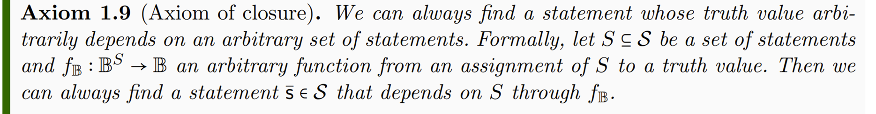


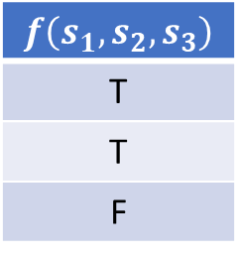
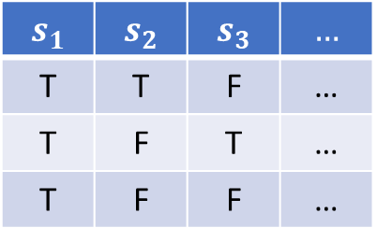
$$s_{1}$$ | $$s_{2}$$ | $$s_{3}$$ | $$…$$
T | T | F | …
T | F | T | …
T | F | F | …
$$f\left(s_{1},s_{2},s_{3}\right)$$
T
T
F
$$f_{𝔹}$$
Notes:
The logical context will allows allow all possible truth functions

Slide 20
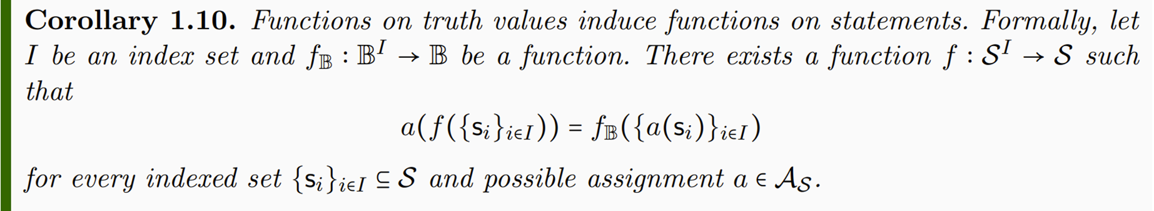

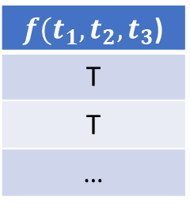
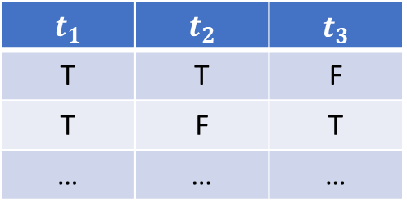
$$t_{1}$$ | $$t_{2}$$ | $$t_{3}$$
T | T | F
T | F | T
… | … | …
$f(t_{1},t_{2},t_{3}$)
T
T
…
Notes:
-> Functions on truth values induce functions on statements

Slide 21
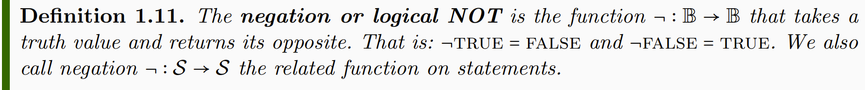
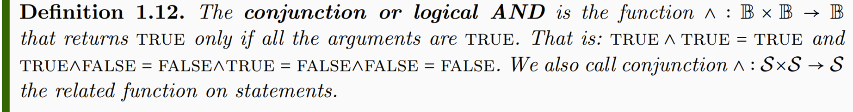
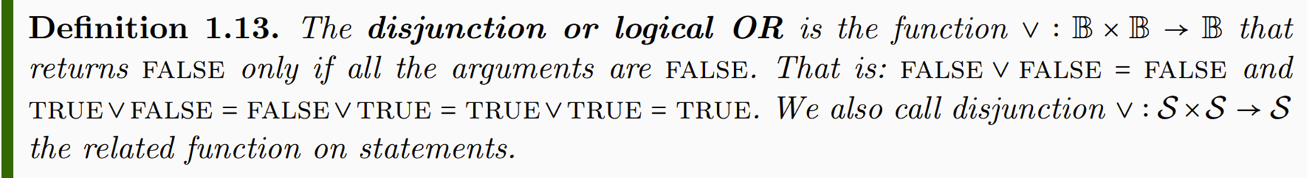

Operator | Gate | Symbol | Example
Negation | NOT | ¬$s_{1}$ | “the mammal is not a cat”
Conjunction | AND | $$s_{1} \text{∧ }s_{2}$$ | “the mammal is a cat and black”
Disjunction | OR | $s_{1 }\text{∨}$ $s_{2}$ | “the mammal is at least a cat or black”

Slide 22

Notes:
Different notion of equivalence Table 1.2

Slide 23


Relationship | Symbol | First statement | Second statement | Also known as
Statement equality | $$s_{1}=s_{2}$$ | “Swans are birds” | “I cigni sono uccelli” | Semantic equivalence
Statement equivalence | $$s_{1}≡s_{2}$$ | “Swans are birds” | “Swans have feathers” | Logical equivalence
Truth equality | truth($s_{1}$)=truth($s_{2})$ | “Swans are birds” | “The earth is round” | Material equivalence

Slide 24


Slide 25



Slide 26


Slide 27




Slide 28


